Slide 1
Week 1 and 2: Distributed Computing (An Overview)
Cloud Computing
Dr. Rafiullah Khan
ICS/IT
www.rafiyz.github.io

Slide 2
Outline
Definition of a Distributed System
Goals of a Distributed System
Types of Distributed Systems

Slide 3
Flynn’s Taxonomy
Flynn’s taxonomy is a classification scheme for computer architectures proposed by Michael Flynn in 1966.
The taxonomy is based on the number of instruction streams and data streams that can be processed simultaneously by a computer architecture.
An Instruction Stream is a sequence of instructions that are read from memory.
Data Stream refers to a continuous flow of data values or information.

Slide 4
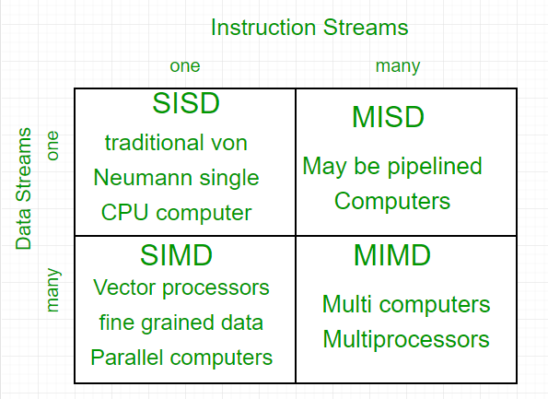
Flynn’s Taxonomy (Cont.)

Slide 5
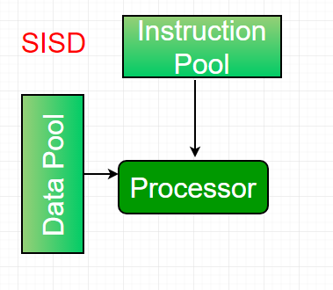
SISD
Single Instruction Single Data (SISD): In a SISD architecture, there is a single processor that executes a single instruction stream and operates on a single data stream.
This is the simplest type of computer architecture and is used in most traditional computers (von neuman architecture).

Slide 6
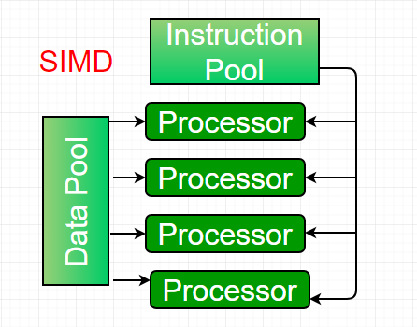
SIMD
Single Instruction Multiple Data (SIMD): In SIMD architectures, a single instruction is broadcasted to multiple processing units that simultaneously operate on different data elements.
This type of architecture is used in applications such as image and signal processing.

Slide 7
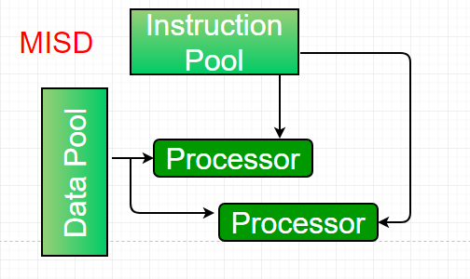
MISD
Multiple Instruction Single Data (MISD): In a MISD architecture, multiple processors execute different instructions on the same data stream.
This type of architecture is not commonly used in practice, as it is difficult to find applications that can be decomposed into independent instruction streams.
Maybe used in fault-tolerant systems where data is replicated and processed by multiple redundant processors using different algorithms.

Slide 8
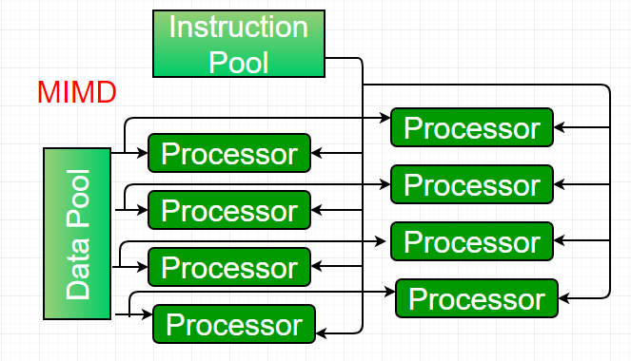
MIMD
Multiple Instruction Multiple Data (MIMD): In a MIMD architecture, multiple processors execute different instructions on different data streams.
This type of architecture is used in distributed computing, parallel processing, and other high-performance computing applications.

Slide 9
Types of MIMD
Shared memory MIMD model (tightly coupled multiprocessor systems), all the PEs are connected to a single global memory and they all have access to it.
The communication between PEs in this model takes place through the shared memory.
Modification of the data stored in the global memory by one PE is visible to all other PEs.
Distributed memory MIMD machines (loosely coupled multiprocessor systems) all PEs have a local memory.
The communication between PEs in this model takes place through the
interconnection network (the inter-process communication channel, or IPC).

Slide 10
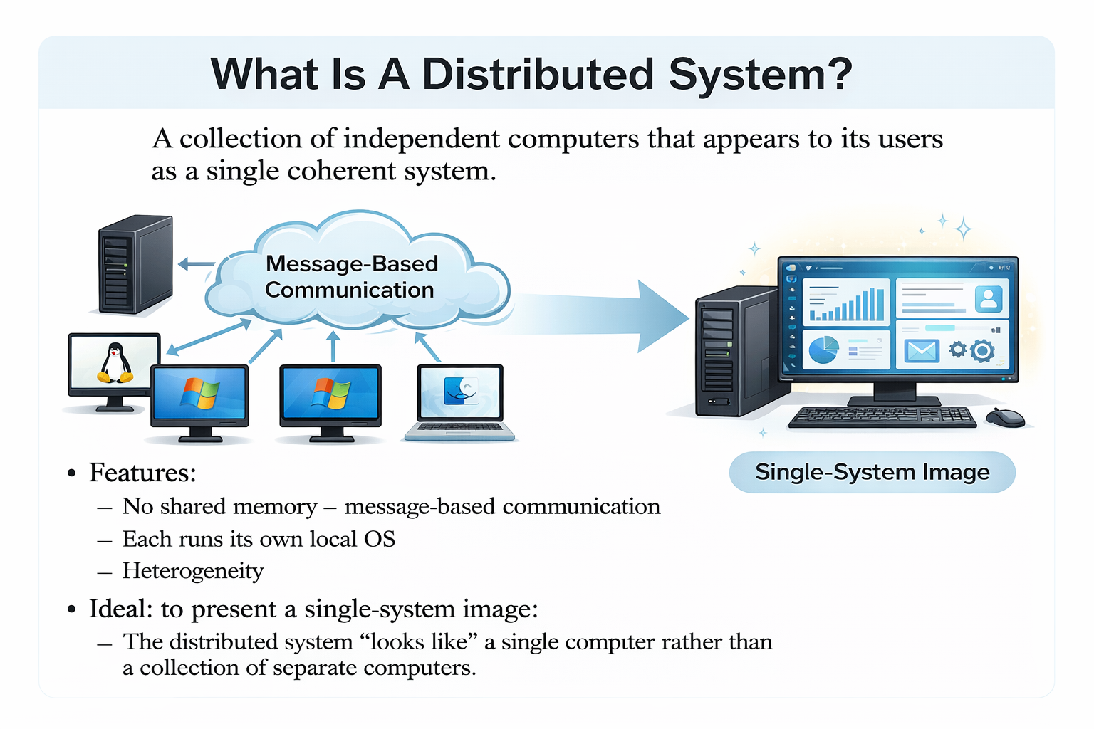
What Is A Distributed System?
A collection of independent computers that appears to its users as a single coherent system.
Features:
No shared memory – message-based communication
Each runs its own local OS
Heterogeneity
Ideal: to present a single-system image:
The distributed system “looks like” a single computer rather than a collection of separate computers.

Slide 11
Distributed System Characteristics
To present a single-system image:
Hide internal organization, communication details
Provide uniform interface
Easily expandable
Adding new computers is hidden from users
Continuous availability
Failures in one component can be covered by other components
Supported by middleware

Slide 12
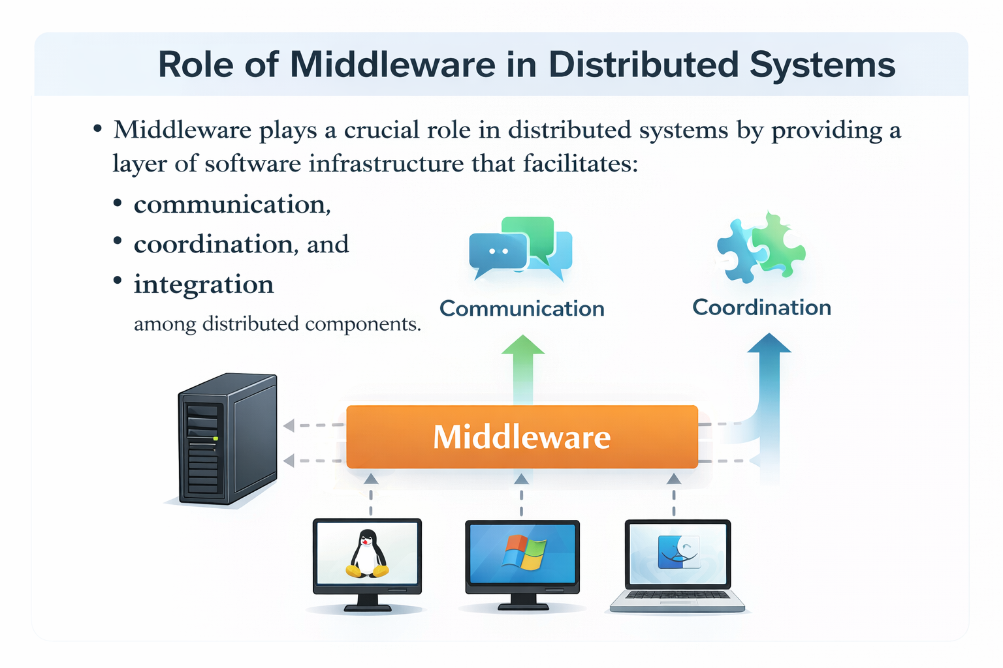
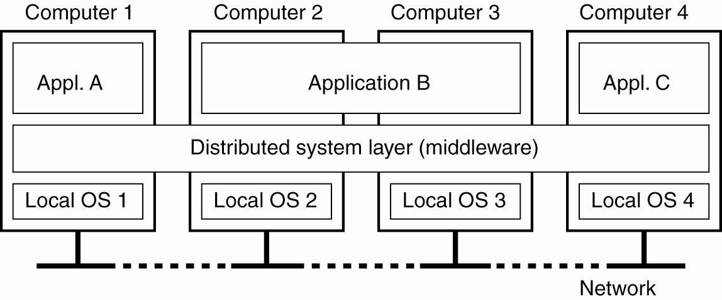
Middleware
Middleware plays a crucial role in distributed systems by providing a layer of software infrastructure that facilitates:
communication,
coordination, and
integration among distributed components.
Figure. A distributed system organized as middleware. The middleware layer runs
on all machines, and offers a uniform interface to the system

Slide 13
Middleware Examples
CORBA (Common Object Request Broker Architecture): Enables communication between distributed software components in different languages and on different platforms.
DCOM (Distributed Component Object Model): Facilitates distributed computing on Windows platforms by allowing communication between software components across networked computers.
Sun’s ONC RPC (Remote Procedure Call): Protocol for making remote procedure calls across a network, allowing clients to invoke procedures on remote servers.
RMI (Remote Method Invocation): Java API enabling objects on one JVM to invoke methods on objects in another JVM over a network.
SOAP (Simple Object Access Protocol): Protocol for exchanging structured information in web services, enabling communication between programs on different operating systems over HTTP and XML.

Slide 14
Middleware Examples
Technology | Full Name | Platform / Language Support | Communication Type | Key Features | Typical Use
CORBA | Common Object Request Broker Architecture | Multi-language, multi-platform | Object-based | Enables interoperability between distributed components written in different languages and running on different platforms | Heterogeneous distributed systems
DCOM | Distributed Component Object Model | Windows-based | Component-based | Supports distributed computing on Windows; integrates tightly with Microsoft technologies | Windows enterprise applications
ONC RPC | Open Network Computing Remote Procedure Call | Platform-independent (commonly Unix/Linux) | Procedure-based | Allows clients to execute procedures on remote servers; simple and efficient | Client-server distributed systems
RMI | Remote Method Invocation | Java-based (JVM) | Object-oriented | Allows Java objects in one JVM to invoke methods of objects in another JVM | Java distributed applications
SOAP | Simple Object Access Protocol | Platform and language independent | Message-based (XML) | Uses XML over HTTP; supports interoperability in web services | Web services and service-oriented architectures

Slide 15
Cont.
All of the previous examples support communication across a network:
They provide protocols that allow a program running on one kind of computer, using one kind of operating system, to call a program running on another computer with a different operating system
– The communicating programs must be running the same
middleware.

Slide 16
Distributed System Goals
Scalability: Distributed systems should be able to scale horizontally or Vertically
Horizontally by adding more machines or nodes to handle increasing workloads. This allows them to
accommodate growing numbers of users or data without significant degradation in performance.
Vertically by adding more resources, such as CPU, memory, or storage, to an existing system to enhance its performance and capacity.
Transparency: Refers to the ability of the system to hide the complexities of its distributed nature from users, applications, and developers.
It aims to make the distributed system appear as if it were a single, cohesive entity, regardless of the underlying distribution of its components across multiple machines, networks, or locations.
There are several dimensions of transparency such as Access, Failure and Migration transparency (next slide)
Openness: The "openness principle" emphasizes the importance of designing distributed systems in a way that promotes openness and interoperability (next slide).
Resource Availability: Making sure that the necessary resources—such as computing power, storage, and network bandwidth—are consistently accessible and usable by users and applications.

Slide 17
Dimensions of Transparency
Transparency | Description
Access | Hide differences in data representation & resource access (enables interoperability)
Location | Hide location of resource (can use resource without knowing its location)
Migration | Hide possibility that a system may change location of resource (no effect on access)
Replication | Hide the possibility that multiple copies of the resource exist (for reliability and/or availability)
Concurrency | Hide the possibility that the resource may be shared concurrently
Failure | Hide failure and recovery of the resource. How does one differentiate betw. slow and failed?
Relocation | Hide that resource may be moved during use
Figure. Different forms of transparency in a distributed system (ISO, 1995)
Notes:
In distributed systems, transparency refers to the ability of the system to hide the complexity of distributed components from users and applications. The goal is to make a distributed system appear as a single, unified system, even though it consists of multiple interconnected computers and resources.
The slide presents different dimensions of transparency, each addressing a specific type of complexity that should be hidden from users.
1. Access Transparency
Access transparency hides differences in data representation and resource access methods. Users can access local and remote resources in the same way without worrying about how the data is stored or formatted. Example: Accessing a remote file in the same way as a local file.
2. Location Transparency
Location transparency hides the physical location of resources. Users do not need to know where a resource is located to use it. Example: Using a web service without knowing the server’s geographic location.
3. Migration Transparency
Migration transparency hides the possibility that a resource or process may move from one location to another. This movement does not affect how users access the resource. Example: Virtual machines migrating between servers without interrupting services.
4. Replication Transparency
Replication transparency hides the existence of multiple copies of resources. Users see only one logical resource, even though multiple replicas exist to improve reliability and availability. Example: Distributed databases with replicated data across multiple servers.
5. Concurrency Transparency
Concurrency transparency hides the fact that multiple users or processes may access the same resource simultaneously. The system ensures consistency without exposing complexity to users. Example: Multiple users editing shared data without conflicts.
6. Failure Transparency
Failure transparency hides system failures and recovery mechanisms from users. The system continues to function despite partial failures. Example: Automatic failover in cloud systems when a server crashes.
7. Relocation Transparency
Relocation transparency hides the movement of resources while they are being used. Unlike migration, relocation happens during active use without disrupting access. Example: Mobile devices switching network connections during a video call.

Slide 18
Openness
An open distributed system “offers services according to standard rules that describe the syntax and semantics of those services.” In other words, the interfaces to the system are clearly specified and freely available.
Compare to network protocols
Not proprietary
Interface Definition/Description Languages (IDL): used to describe the interfaces between software components, usually in a distributed system
Definitions are language & machine independent
Support communication between systems using different OS/programming languages; e.g. a
C++ program running on Windows communicates with a Java program running on UNIX
Communication is usually RPC-based.

Slide 19
Examples of IDLs
IDL: Interface Description Language
The original
WSDL: Web Services Description Language
Provides machine-readable descriptions of the services
OMG IDL: used for RPC in CORBA
OMG – Object Management Group

Slide 20

Comparative Table of IDL, WSDL, and OMG IDL
Aspect | IDL (Interface Description Language) | WSDL (Web Services Description Language) | OMG IDL (CORBA IDL)
Full Name | Interface Description Language | Web Services Description Language | Object Management Group Interface Description Language
Organization / Origin | General concept (original interface specification language) | W3C (World Wide Web Consortium) | OMG (Object Management Group)
Purpose | Defines interfaces for software components in distributed systems | Describes web services in a machine-readable format | Defines interfaces for remote objects in CORBA
Communication Model | Remote Procedure Call (RPC) / Distributed systems | Web Services (SOAP/HTTP) | RPC-based object communication in CORBA
Technology Context | Early distributed systems | Service-Oriented Architecture (SOA) and Web Services | CORBA middleware
Language / Format | Language-neutral specification | XML-based language | CORBA-specific IDL syntax
Platform Dependency | Platform-independent (conceptual) | Platform-independent | Platform-independent (within CORBA framework)
Key Feature | Original method for defining interfaces between components | Describes service operations, messages, and endpoints | Enables interoperability between heterogeneous systems using CORBA
Typical Use | Interface specification in distributed computing | Web service description and discovery | Distributed object communication in CORBA systems

Slide 21
Summary Goals for Distribution
Resource accessibility
For sharing and enhanced performance
Distribution transparency
For easier use
Openness
To support interoperability, portability, extensibility
Scalability
With respect to size (number of users), geographic distribution, administrative domains

Slide 22

Issues/Pitfalls of Distribution
Requirement for advanced software to realize the potential benefits. Distributed systems are inherently more complex than centralized systems
Security and privacy concerns regarding network communication
Replication of data and services provides fault tolerance and availability, but at a cost.
Network reliability, security, heterogeneity, topology

Slide 23
Example of Distributed System
Distributed systems run distributed applications, from file sharing to large scale projects like SETI@Home http://setiathome.ssl.berkeley.edu/

